Slide 1
SAS Programming
SAS Structure
Programming With SAS

Slide 2
Outline
Understanding SAS Programming language
SAS System structures
SAS Data Sets and Data Libraries
Creating SAS Data Sets
SAS I/O
SAS Programming

Slide 3
Why SAS?
Able to process large data sets
Easy to cope with multiple variables
Able to track all the operations on the data sets
Generate systematic output
Summary statistics
Graphs
Many government agencies and private sectors use SAS
For e.g., US FDA only accepts the statistical analysis reports generated in SAS from pharmaceutical companies

Slide 4
SAS Structure
Data Step
.txt
.dat
.xlsx
SAS Data Set
.dbms
Analyze the Data
PROC MEANS
PROC REG
PROC SORT
PROC VARMAX
PROC GLM

Slide 5
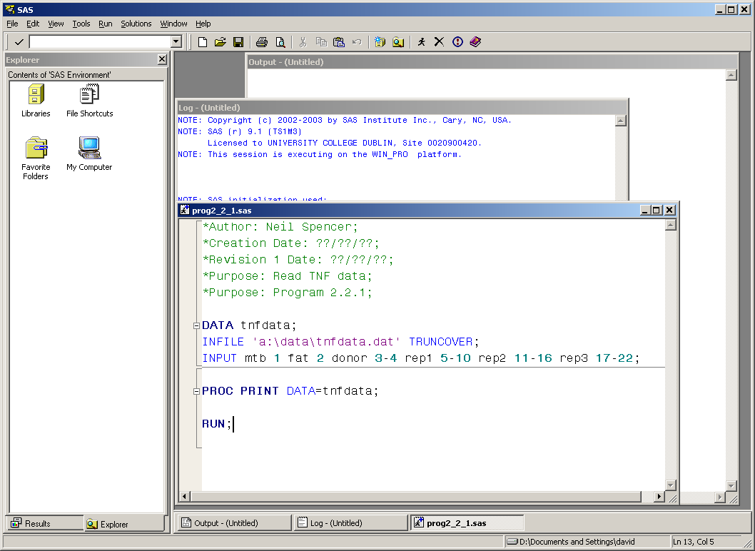
SAS Windows

Slide 6
SAS Windows
Editor
Where code is written or imported, and submitted
Log
What happened, including what went wrong
Output
Results of program procedures that product output
Explorer
Shows libraries (directories), their files, and where you can see data, graphs

Slide 7
Basic rules – organize files
.sas – program file
.log – notes, errors, warnings
.lst – output
.sas7bdat – data file generated by sas system
libarary – a cabinet to put data in
Default : work
Temporary, erased after you close the session
Permanent library
libname ( your library name – for e.g. mylib) (your data directory : for e.g. “c:\....”)
For e.g. libname mylib “c:\”;
mylib.mydata == a sas data file named “mydata” in library “mylib”

Slide 8
Basic rules - program
Every commands ends with ;
Format does matter
if x = 1 then y = 1; else y = 2; is the same as
if x = 1 then y = 1;
else y = 2;
Case insensitive
Comment or footnote
*this is comment;
/*this is comment*/

Slide 9
Basic rules - variable
Variable type
Numeric (default : 8 digit, missing : .)
Character (default : 8 digit , missing : blank)
Variable names
<= 32 characters
Case insensitive
Variable name must start with letter or “_”
Ok : _name , my_name, zip5, u_and_me
Not OK : -name, my-name, 5zip, per%, u&me, my@w, my$sign

Slide 10
Missing data values
A value must exist for every variable for each observation.
Missing values are valid values
A numeric missing value is displayed as a period.
LastName FirstName JobTitle Salary
TORRES JAN Pilot 50000
LANGKAMM SARAH Mechanic 80000
SMITH MICHAEL Mechanic . WAGSCHAL NADJA Pilot 77500
TOERMOEN JOCHEN 65000
A character missing value is displayed as a blank.

Slide 11
Step Boundaries
SAS steps begin with a
DATA statement
PROC statement.
SAS detects the end of a step when it encounters
a RUN statement (for most steps)
a QUIT statement (for some procedures)
the beginning of another step (DATA statement or PROC statement).
Recommendation: use RUN; at end of each step

Slide 12
Basic rules (4) – data step
create a new data set called “newdata” in the temporary library
Data step
DATA newdata;
set proj3rawdata;
fracuninsured=uninsured/total;
percentuninsured=fracuninsured*100;
run;
use the data set called “proj3rawdata” in the temporary library
Define new variables
input data “proj3rawdata”
obs1
obs2
…
obs n
output data “newdata”
obs1
…
obs n
define “fracuninsured”
define “percentuninsured”

Slide 13
Basic rules (5) – proc step
PROC step
PROC PRINT data=newdata;
var fracuninsured percentuninsured;
title “print out new data”;
run;
Action
Data source
Signal the end of PROC step, could be ignored if this is followed by a Data or Proc step
Notes:
data=distance can be ignored, if you refer to the latest data used in the same program
run can be ignore, SAS automatically realize the end of proc when it encounters another data or proc step

Slide 14
Data Screening checking input data for gross errors
Use PRINT procedure to scan for obvious anomalies
Use MEANS procedure & examine summary table
MAXIMUM, MINIMUM – reasonable?
MEAN - near middle of range?
MISSING VALUES - input or calculation error e.g. log(0)?
CV (= 100*std.dev/mean) - < 10% for plant growth, between 12 & 30% for animal production variables, > 50% implies skewness for any positive variable

Slide 15
SAS syntax
MEANS syntax
What else should go here?

Slide 16
Dealing with data errors
Check original records
Change mistakes in recording where the correct value is beyond question
Regenerate observations where possible
e.g. reweigh sample, redo chemical analysis
With a large body of data in an unbalanced design err on the side of omitting questionable data
Do not proceed until data has been properly cleaned – if necessary perform a number of screening runs

